Slide 1
Database Systems
Lesson 2: The Relational Database Model

Slide 2
Relational Model
Dr. E. F. Codd proposed the relational model for database systems in 1970.
It is the basis for the relational database management system (RDBMS).
The relational model consists of the following:
  Collection of objects
    domain, attribute, relation, tuple, primary key, degree, cardinality
  Data integrity for accuracy and consistency
    entity integrity and referential integrity
  Set of operators to act on the relations
    relational algebra, relational calculus

Slide 3
Relational Model Objects
Domain
  a set of atomic (indivisible) values
  are pools of values from which the actual values appearing in attributes are drawn
  specify
      name
      data type
      data format
Examples:
  gender domain
    one character string with allowable values of M, m, F, f
  name domain
    twenty character string
  credit_limit domain
    money in the range $1,000 to $99,999

Slide 4
What is NULL?
NULL is NOT a value
  is a representation of the fact that there is NO VALUE
Reasons for a NULL:
  VALUE NOT APPLICABLE -
    EMP relation - empno, deptno, salary, commission
      commission only applies to staff in sales dept
  VALUE UNKNOWN -
    Joe's salary is NULL, Joe’s salary is currently unknown

Slide 5
NULL
  VALUE DOES NOT EXIST -
    Tax File Number - is applicable to all employees BUT Joe may not have a number at this time
  VALUE UNDEFINED -
    Certain items explicitly undefined eg. divide by zero
      Columns Number_of_payments, Total_payments
      Column Average_payment_made
      If Number_of_payments = 0 => Average undefined

Slide 6
Any mathematical operations performed on NULL will result in NULL. For example,
10 + NULL = NULL
Aggregate functions such as SUM, COUNT, AVG, MAX, and MIN ignore NULL values.

Slide 7
Example
Table Sales_Data
SELECT SUM (Sales), AVG (Sales), MAX (Sales), MIN (Sales), COUNT (Sales) FROM Sales_Data;
RESULT
Note that the AVG function counts only 3 rows (the NULL row is excluded), so the average is 600 / 3 = 200, not 600 / 4 = 150. The COUNT function also ignores the NULL row, which is why COUNT (Sales) = 3.
Store_Name | Sales
Store A | 300
Store B | 200
Store C | 100
Store D | NULL
SUM(Sales) | AVG(Sales) | MAX(Sales) | MIN(Sales) | COUNT(Sales)
600 | 200 | 300 | 100 | 3

Slide 8
Relational Model Objects
Relation
  a named set of attributes
  consists of two parts: a heading and a body
  We may map relation to the ‘concept’ of a table.
Relation Heading
  also called a Relational Schema consists of a fixed set of attributes
Diagrammatic
Representation
custno
custname
custadd
credlimit
Notes:
Every table is not a relation but every relation is a table

Slide 9
Relation
Relation Body
  tabular representation – data rows
custno
custname
custadd
credlimit
Relation heading
SMI13
SMITH
Wide Rd, OnePlace, 1111
2000
JON44
Relation body
JONES
Narrow St, Somewhere 2222
10000
BRO23
BROWN
Here Rd, Lost, 3333
10000

Slide 10
Relation Properties
No duplicate tuples
  by definition sets do not contain duplicate elements
    hence tuples are unique
Tuples are unordered within a relation
  by definition sets are not ordered
    hence tuples can only be accessed by content
No ordering of attributes within a tuple
    by definition sets are not ordered
No multivalued attributes in a relation
    an entry at an intersection of each row and column is atomic (single-valued)
Notes:
Resolving multi valued attributes will be discussed in detail in the following lessons

Slide 11
Logical View of Data
Relational Database
  Designer focuses on logical representation rather than physical
  Using a logical tabular representation of the data has several advantages
    Structural and data independence
    Related records stored in independent tables
    Logical simplicity
  Allows for more effective design strategies
Entities and Attributes
  Entity is a person, place, event, or concept about which data is collected
  Attributes are characteristics of the entity
Tables
  hold related entity occurrences (an entity set)
  consist of rows and columns
Notes:
Two-dimensional structure with rows and columns
Rows (tuples) represent a single entity occurrence
Columns represent attributes
Row/column intersection represent a single value
Tables must have an attribute or collection of attributes to uniquely identify each row (fundamental property of relation)
All values in a column are from the same domain
Each column has range of values called the attribute domain
Order of the rows and columns is immaterial to the DBMS

Slide 12
Relational Model – Tabular Representation
COLUMN
or
ATTRIBUTE
SMI13
SMITH
Wide Rd, OnePlace, 1111
2000
ROW
or
TUPLE
JON44
JONES
Narrow St, Somewhere 2222
10000
BRO23
BROWN
Here Rd, Lost 3333
10000
JON16
JONES
Wide St, Nowhere, 3009
1000
WHI05
WHITE
Fly Rd, Somewhere, 2980
5000
GRE21
GREEN
Palace St, Berwick, 3806
20000
Field

Slide 13
Basic Building blocks
Entities
  Refers to the entity set and not to a single entity occurrence (instance) eg. the ‘set’ of all students
  Corresponds to a table and not to a row in the relational environment
  In both the Chen and Crow’s Foot models, an entity is represented by a rectangle containing the entity’s name
Attributes
  Characteristics of entities
  Domain is the set of all possible values
  Primary keys underlined

Slide 14
Two types of Entity Relationship Model
Chen Model
Crow’s Foot Model
In both models, an entity is represented by a rectangle containing the entity’s name
  Entity name, a noun, is usually written in capital letters and in singular form
  Eg: STUDENT not STUDENTS
Notes:
Note: In our course of study, we would focus on Crow’s Foot Model

Slide 15
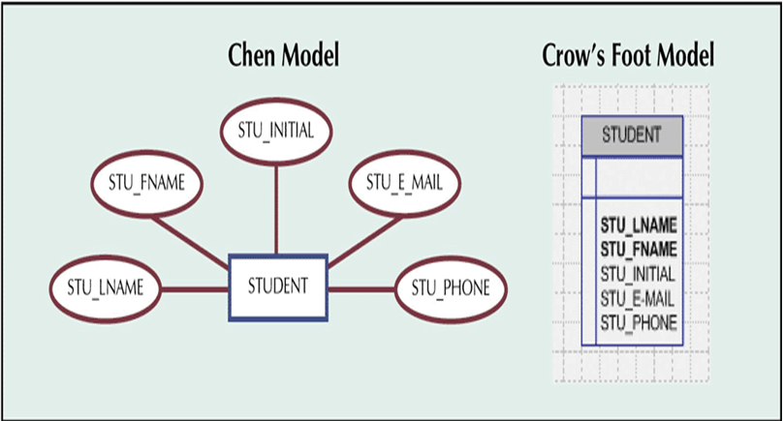
Attributes are represented as…
Notes:
Figure: Attributes of the STUDENT entity
Note no PK has been selected/shown as yet

Slide 16
Types of Attributes…
Consider the Student entity with the following attributes
Student (stu_Email, stu_MiddleName, stu_FirstName, stu_DOB, stu_Phone, stu_LastName).
Simple Attributes | Composite Attributes
Cannot be subdivided | Can be subdivided
Eg: stu_firstname,stu_lastname | Eg: stu_Name which could be divided stu_FirstName,stu_LastName,stu_MiddleName
Required Attribute | Optional attribute
Must have a value | May not have a value
Eg: stu_FirstName,stu_LastName | Eg: stu_MiddleName
Notes:
Note: The primary key chosen has been underlined.

Slide 17
Single valued Attribute | Multi-Valued Attribute
Can have only one value | Can have multiple values
Eg: stu_LastName | Eg: stu_Address
Key Attribute | Non key Attribute
Attribute or group of attributes that uniquely identify that entity (usually the primary, composite key) | All attributes other than key attribute are Non key attributes
Eg: stu_EMAIL | Eg: stu_MiddleName,stu_FirstName, stu_DOB, stu_Phone, stu_LastName.
Stored Attribute | Derived Attribute
Value is stored and supplied to another attribute | Value is calculated or derived
Eg: stu_DOB | Eg: stu_Age

Slide 18
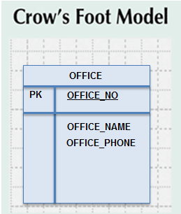
A Multivalued Attribute in an Entity
Notes:
Multivalued attribute is one which can have multiple values
Example: An office may have several phone numbers for different employees in the same office.
Figure : OFFICE _PHONE attribute can have multiple values as every staff in an office will have different phone numbers.

Slide 19
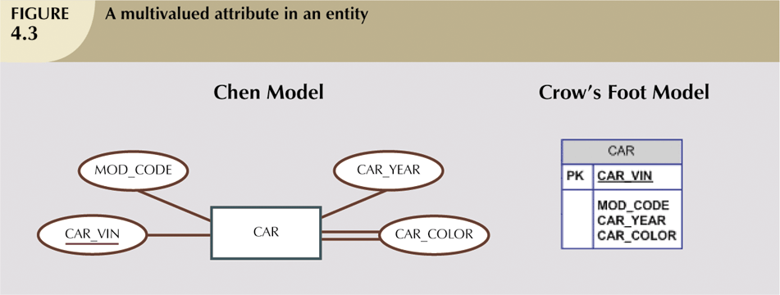
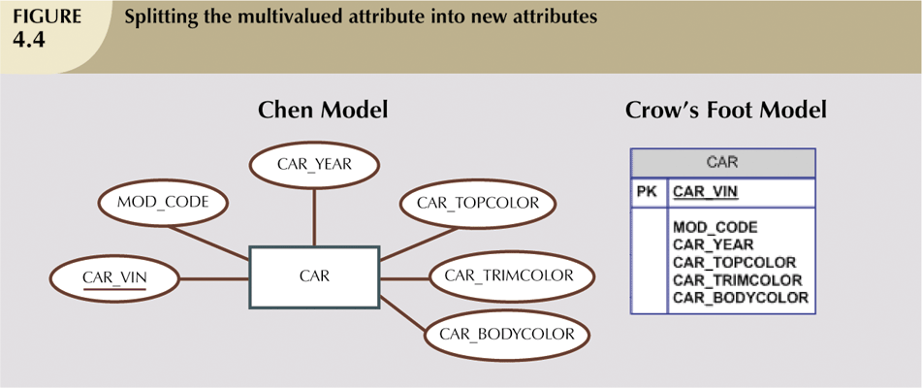
Resolving Multivalued Attribute Problems
Although the conceptual model can depict multivalued attributes, you cannot implement them directly in the relational model.
Instead within original entity, if we create several new attributes, one for each of the original multivalued attribute’s components
    Can lead to major structural problems in the table
OFFICE
PK
OFFICE_NO
OFFICE_NAME
OFFICE_PHONE1
OFFICE_PHONE2
OFFICE_PHONE3
Notes:
Figure shows OFFICE_PHONE attribute can be split into OFFICE_PHONE1, OFFICE_PHONE2 and OFFICE_PHONE3.
Structural problem which arises would be that some offices have many phone numbers and others may have fewer phone numbers. And so many of those fields will be null for many rows.
Another example could be, a company can have multiple locations (i.e) branches,,, so it i

Slide 20
  So ,create a new entity composed of original multivalued attribute’s components
  The new entity is related to the original entity in a 1:M relationship
  In our example of OFFICE entity, office phone needs to be defined only for those offices that have phone. This is done in the PHONE_SERIALNO attribute of the new entity OFFICE_PHONE

Slide 21
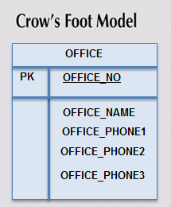
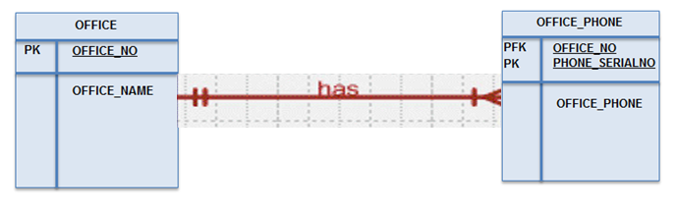
Resolving Multivalued Attribute Problems (continued)

Slide 22
Activity – Multi-valued attributes
A Tutor can have many qualifications
The Relational Model does not allow for multiple values
How would you fix this problem?
Tutor ID | Qualification
John | BSc, MA, PhD
Mohammed | BA, MSc, PhD
Zainab | BSc, MSc, PhD

Slide 23
Key Constraints
Primary Key (PK) - subset of attributes which uniquely identify a row
    A primary key in one entity cannot be the same as the primary key in another entity, i.e. It must be unique.
    Primary keys for the CUSTOMER relation:
      PK(Customer) = (custno, custname)
      PK(Customer) = (custno)
A relation may have more than one potential primary key, this is known as a candidate key
    EMPLOYEE(emp#,.........,taxfile#)
      Each key ⇨ candidate key (CK)
        Chosen key ⇨ primary key (PK)
A Foreign Key is an attribute whose values match the primary key in the related table.

Slide 24
Summary of Keys
Primary key
  Any key that uniquely identifies each entity
Candidate key
  A potential primary key.
Secondary key
  Used only for data retrieval
Composite key
  Composed of more than one key attribute
Key attribute
  Any attribute that is part of a key
Foreign key
  Values must match a primary key in another table
Notes:
Connections (relationships) between relations are supported by attributes which are common to both relations
Primary Key (PK)
an attribute or attributes that uniquely identify a tuple in a relation
Foreign Key (FK)
an attribute or combination of attributes of one relation R2 whose values are required to match those of the PK of relation R1, or be null
a FK and the corresponding PK should be defined from the same domain

Slide 25
Relationships
Association between entities
Connected entities are called participants
Relationships between entities always operate in both directions
Connectivity
  describes relationship classification
    1:1
    1:M
    M:N
Cardinality
  expresses number of entity occurrences associated with one occurrence of related entity

Slide 26
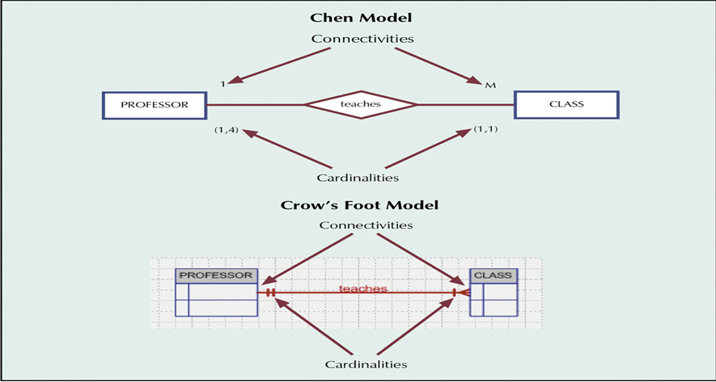
Relationship Connectivity and Cardinality
Notes:
Relationship Connectivity and Cardinality are established by concise statements called Business Rules which define conditions that the database/relational model must meet.
Examples of Business Rules:
A Customer may have zero,one or many ORDERS
A BOOK has one and only one ISBN

Slide 27
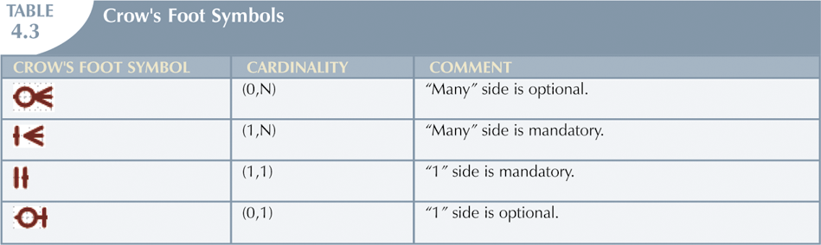
Crow’s Foot Participation
In some variations of Crows Foot symbols (1,1) is shown as a single crossing line to represent one and only one
Notes:
In figure, Cardinality shows minimum and maximum number of entity occurrences associated with one entity occurrence of the related entity .

Slide 28
Relationship Participation
Optional:
  One entity occurrence does not require a corresponding entity occurrence in a particular relationship
Mandatory:
  One entity occurrence requires a corresponding entity occurrence in a particular relationship

Slide 29
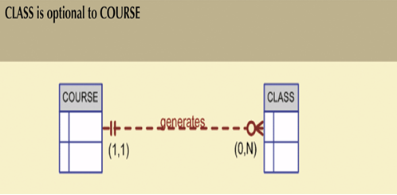
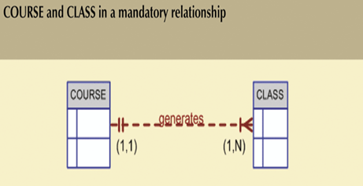
Crow’s Foot Participation
Figure: A
Figure: B
Notes:
Figure A:
A course has minimum of zero class or maximum of N class
A class has a minimum of 1 course and maximum of 1 course
Figure B:
A course has minimum of 1 class or maximum of N class
A class has a minimum of 1 course and maximum of 1 course

Slide 30
Group Activity 2
Give two examples of each of the following relationships:
  1:1
  1:M
  M:N
Give two examples of Cardinality in a Student/Polytechnic database

Slide 31
Existence Dependence
Existence dependence
  An entity exists in a database only when it is associated with another related entity occurrence
    e.g. CUSTOMER places ORDER
Existence independence
  Entity can exist apart from one or more related entities
  Sometimes such an entity is referred as strong or regular entity
Many (most) entities on an ER are existence dependant

Slide 32
Relationship Degree
Indicates number of associated entities or participants
Unary relationship
  Association is maintained within a single entity
Binary relationship
  Two entities are associated
Ternary relationship
  Three entities are associated

Slide 33
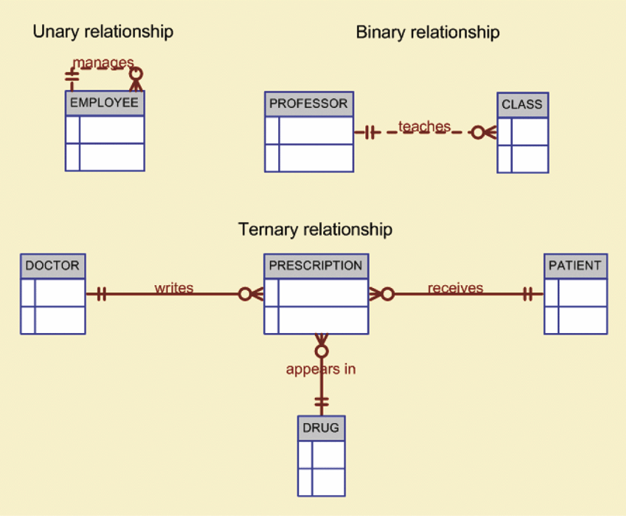
Three Types of Relationships

Slide 34
COMPOSITE Entity
The entity composed of keys of the two related entities is known as a COMPOSITE or ASSOCIATIVE or BRIDGING ENTITY
  associative entity is existence-dependent
M:N is equivalent to two 1:M and M:1 relationships
  sometimes better to model in this manner, especially when composite is a ‘real’ thing or you wish to add relationships to composite

Slide 35
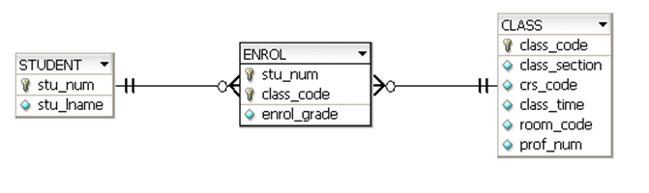
The M:N Relationship between STUDENT and CLASS
Context
ERD
enrol
STUDENT
CLASS
Fully Attributed ERD
Software tools modeling at the Logical ERD level do not allow the
designer to draw M:N relations (two 1:M relationships must be used)

Slide 36
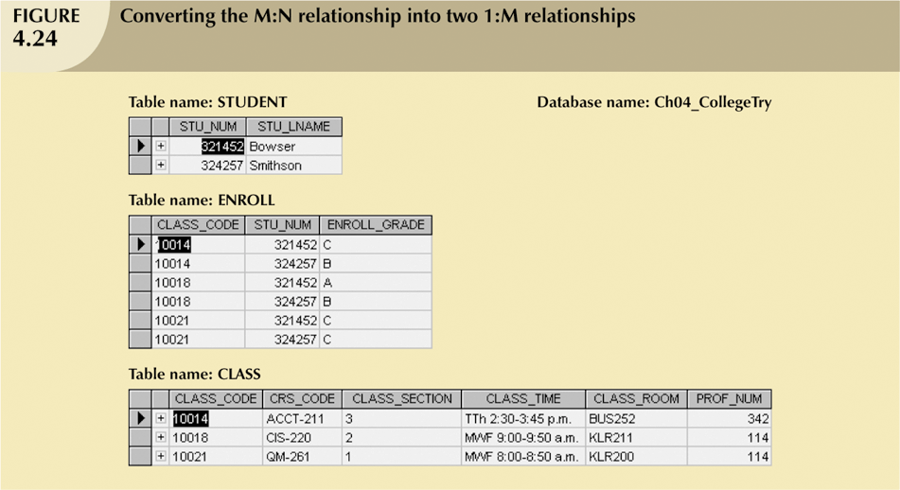
Converting the M:N Relationship into Two 1:M Relationships

Slide 37
Summary
This lecture
  Explain the features of the Relational Model: Components of a relation, Properties of a relation, Null values, and Relational Operators
  Appreciate that the relational database model takes a logical view of data and how data redundancy is dealt with
  Describe the basic relational database components: Entities, Attributes, Relationships amongst entities, Integrity constraints, and Data Dictionary
  Describe the relational table's components and characteristics and contrast the table with a relation
  Explain how keys are used in the relational database environment: candidate keys, primary keys, alternate keys, foreign keys, and secondary keys

